Slide 1
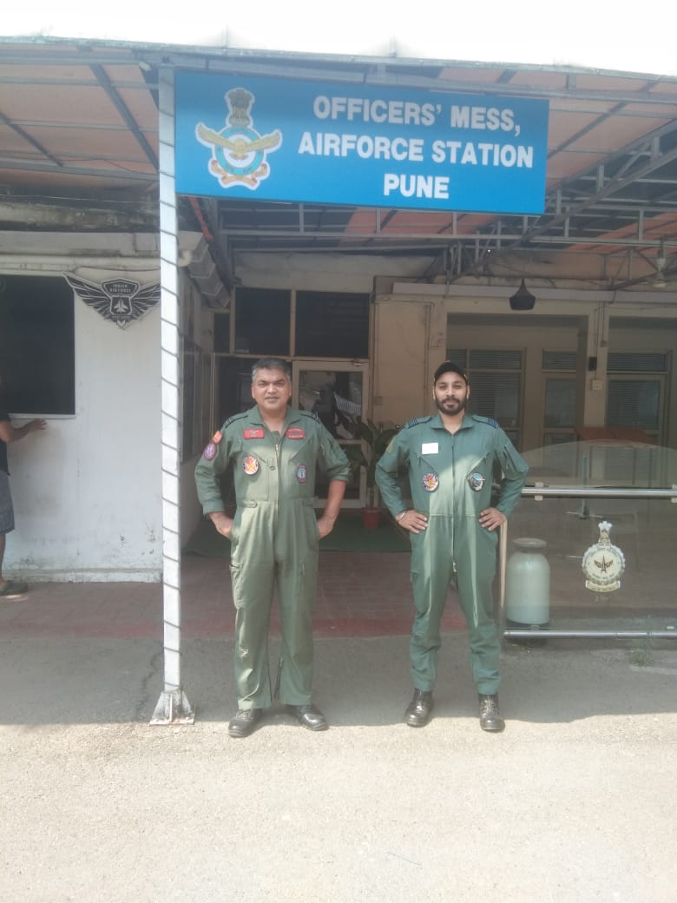
BUSINESS ANALYSIS OFFICERS’ MESS AIR FORCE STATION PUNE

Slide 2
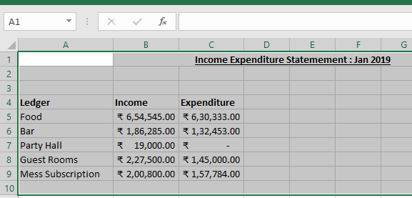
META DATA
DATA OBTAINED FROM 01 JAN 2019 TO DEC 2022
DATA IN FROM OF EXCEL SHEETS FOR EVERY MONTH
MAIN LEDGERS:
FOOD
BAR
GUEST ROOMS
PARTY HALLS
MESS SUBSCRIPTION
INTEREST FROM BANK

Slide 3
TOTAL PROFIT

Slide 4
PROFIT & EXPENDITURE
7.4%

Slide 5
MONTHLY PROFITS

Slide 8
FINDINGS & RECOMMENDATIONS
ROLE OF INTEREST FROM BANK
ROLE OF MESS SUBSCRIPTION
GUEST ROOMS & THEIR UPKEEP
PARTYING HABIT
ORGANISATIONAL CULTURE
TAKE AWAYS FOR BUSINESS MODELS IN HOSPITALITY SECTOR

Slide 9
?

Slide 13
TAKE AWAYS
FIXED DEPOSIT IN BANK
FACILITIES ON SUBSCRIPTION BASIS
ROOMS UPKEEP
INCENTIVES FOR PARTYING (OFFERS ON WEEKENDS)

